Slide 1
Court and Tribunal Hearings (CaTH) service user guide
For legal professionals and members of the media

Slide 2
Overview of Court and Tribunal Hearings service
  The Court and Tribunal Hearings service (CaTH) will be HMCTS’s lead service where all HMCTS public and press hearing information will be published to uphold the principles of open justice. The aim of the service is to provide professional users, the media and the public access to hearing information in a clear and consistent way on GOV.UK.
  CaTH contains a verified user space where legal professionals and members of the media can access enhanced information that they are entitled to, but that should not be in the public domain.
  To provide smoother access for legal professional users, CaTH is integrated with MyHMCTS, the case management system for the Civil, Family and Tribunals jurisdiction and will soon integrate with Common Platform. Journalists can create an account on CaTH by following the guidance on the next few slides.
Purpose
This guide provides an overview of the Court and Tribunal Hearings service (CaTH) and explains how you can create an account to view information and subscribe to hearing lists of interest.

Slide 3
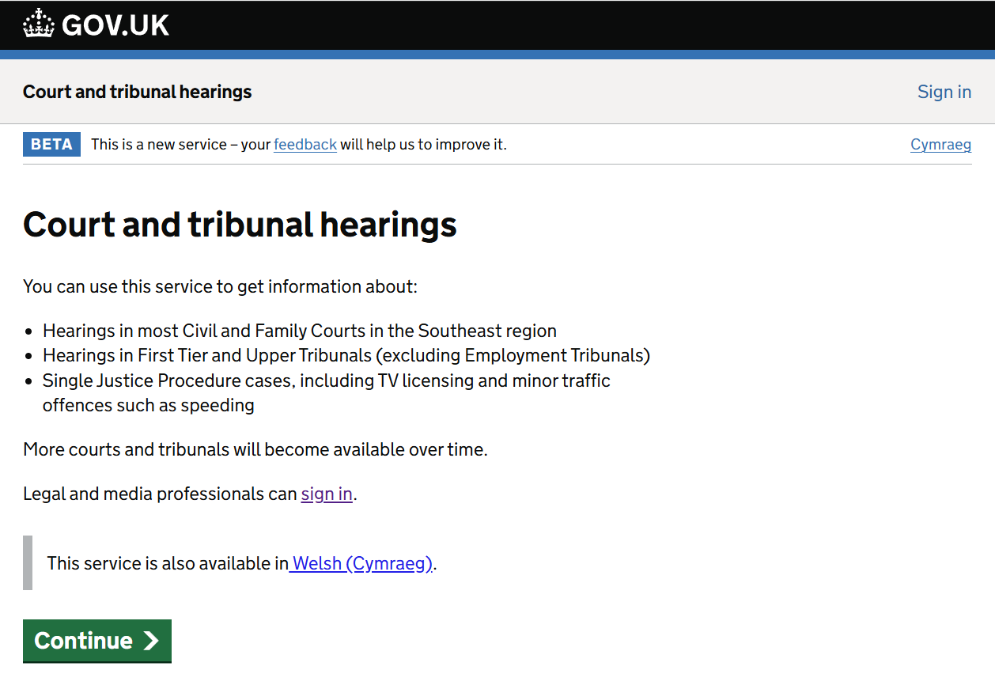
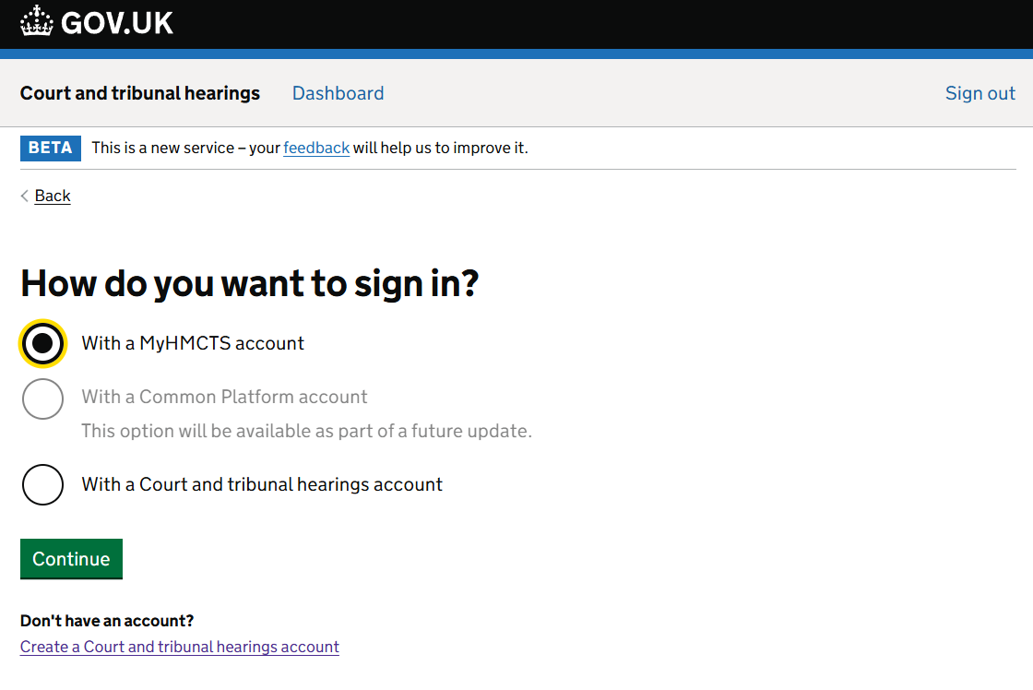
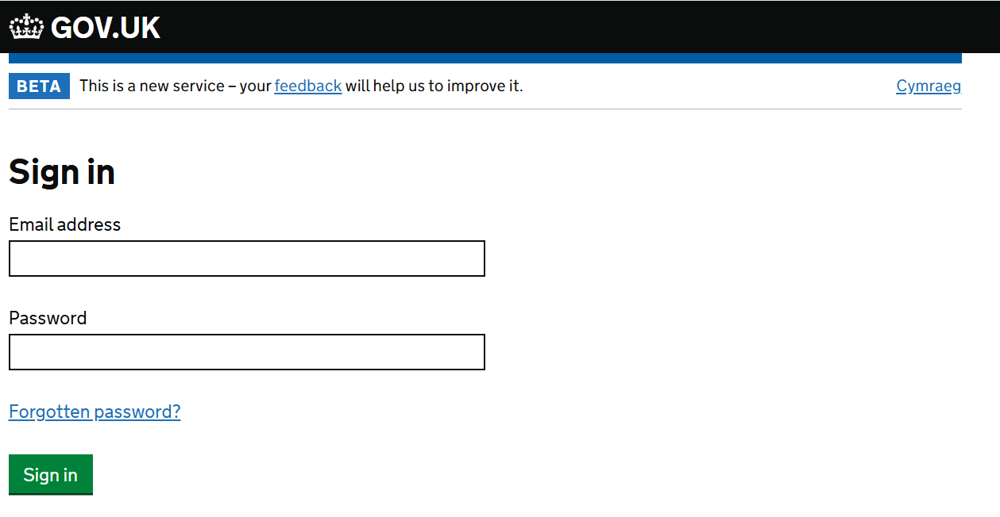
Accounts for professional users
If you are a professional user with a MyHMCTS account, you are entitled to have an account on CaTH which will be automatically created for you. You will need to sign in using the same email address and password you use when signing in to MyHMCTS.
The system will shortly be integrating with Crime and if you have a Common Platform account, the same will apply. The system will be updated to reflect when available, and we will also inform users via our Weekly Update which is published every Friday. You can sign up for the updates.
How to Sign in to your account

Slide 4
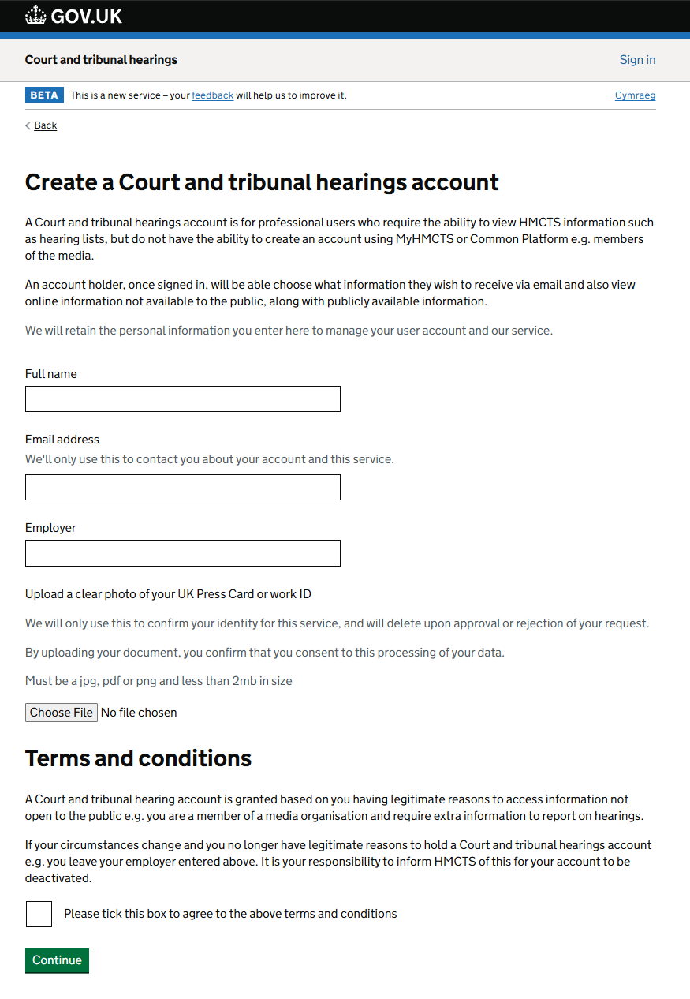
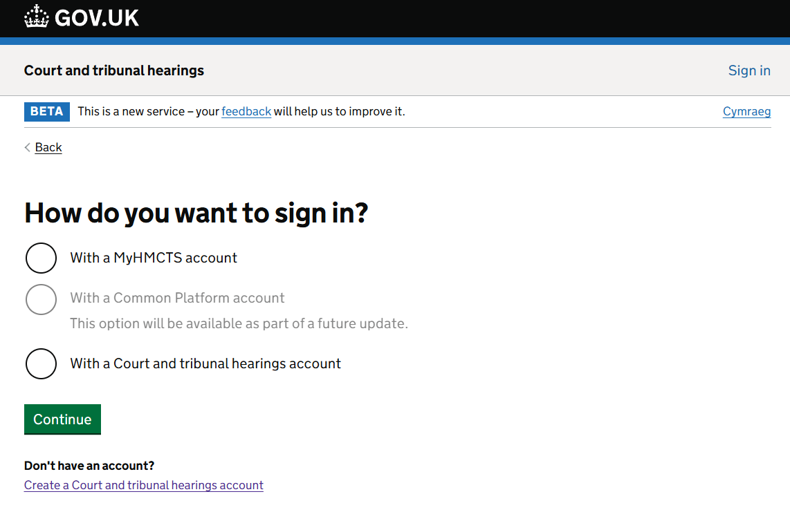
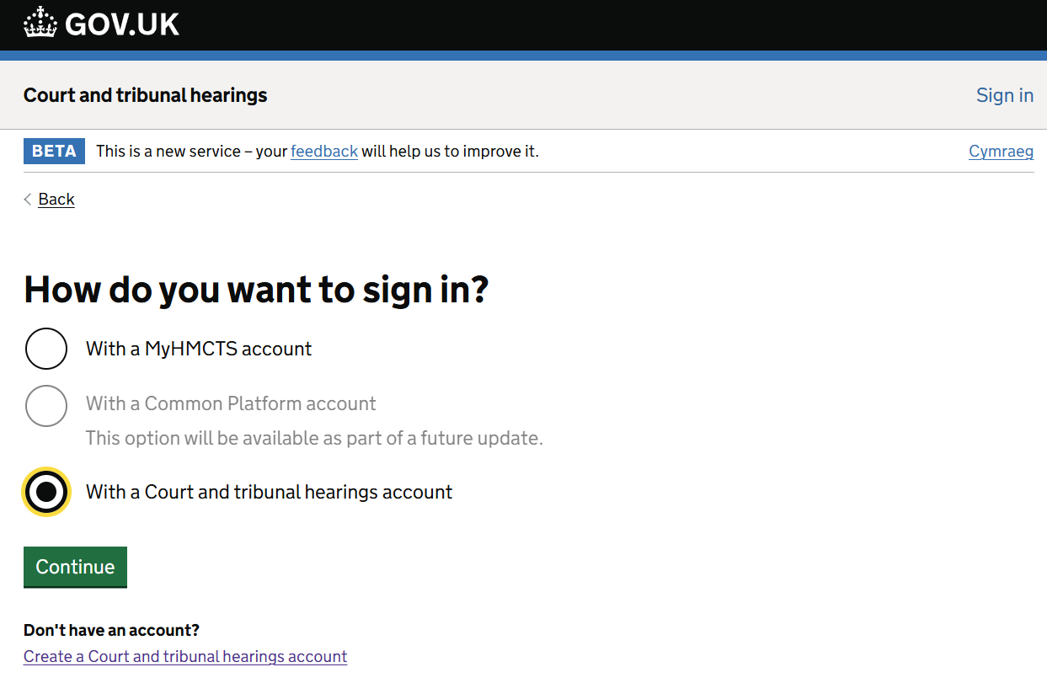
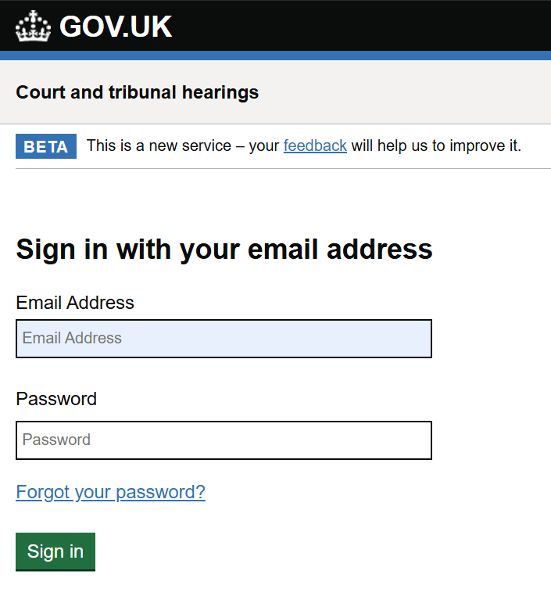
Accounts for members of the media
If you are a member of the media, you are also entitled to have an account on CaTH but will need to create an account. To do so, you will be required to upload a clear photo of your UK Press Card or work ID. Once you have an account you can sign in using the email address and password provided as part of your account creation.
How to create an account
How to sign in to an existing account

Slide 5
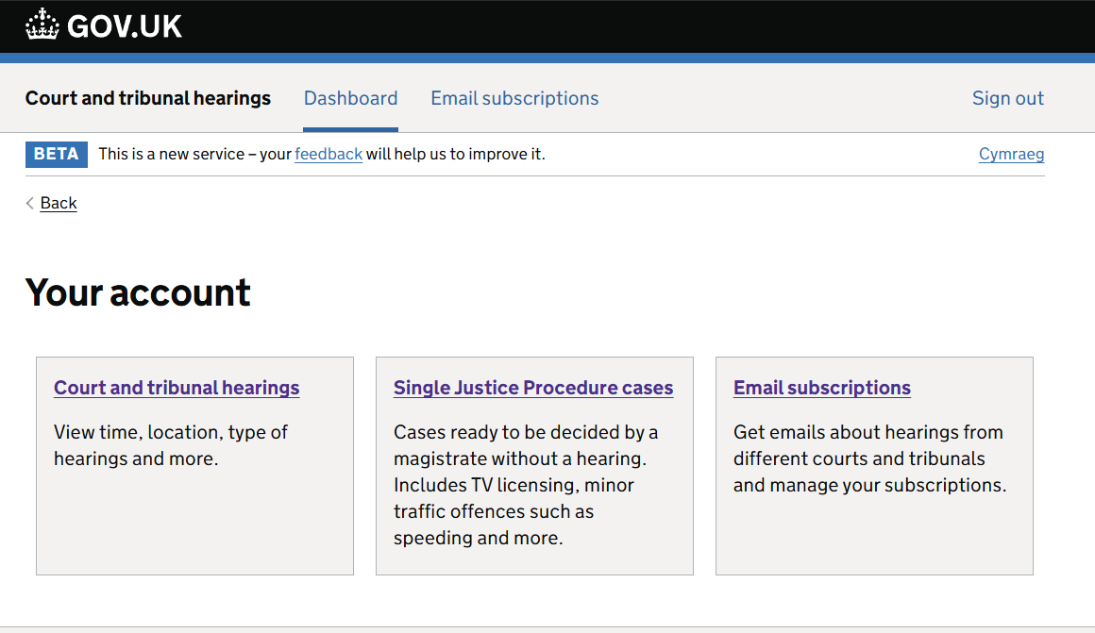
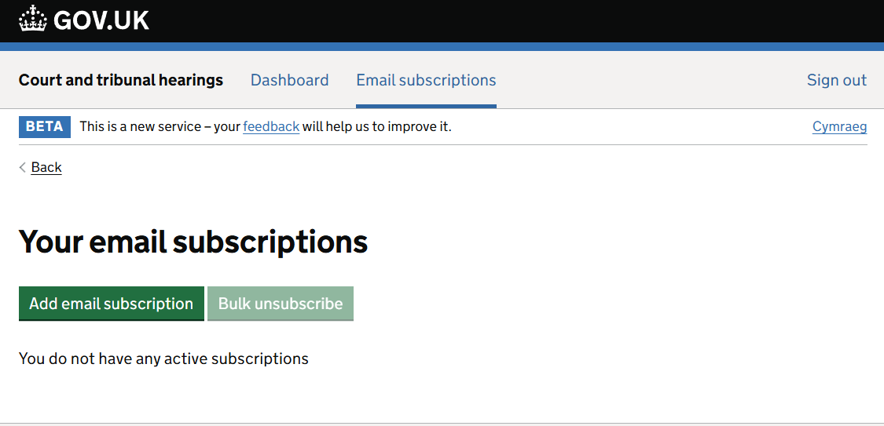
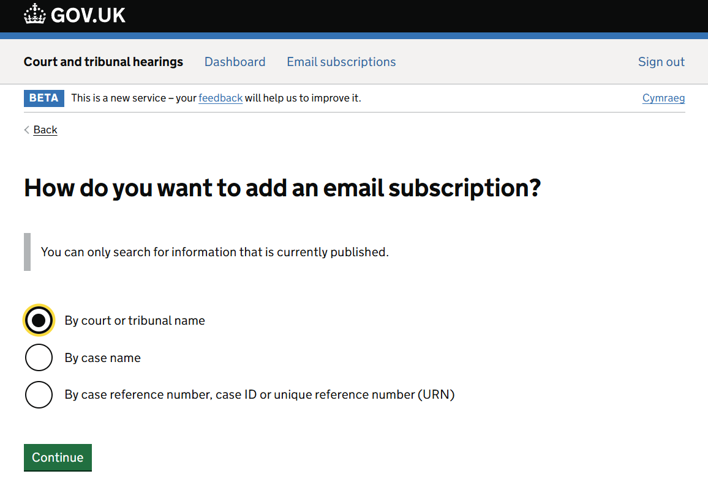
Email subscription
When you sign into your account you will be taken to your dashboard where you will find the ‘Email subscription’ tab. This is where you can subscribe to email notifications of any lists you wish to receive.
Once subscribed to a particular list type you will be emailed each time the list is published on CaTH. Your email subscription will contain a summary of the cause list in the body of the email (excluding Single Justice Procedure (SJP) lists due to the volume of cases), and you will also be sent a link to view and download the full list as a PDF (apart from SJP lists for which you will be sent a link to an Excel document).
Adding an email subscription by court or tribunal name
Choose how you want to add a subscription
Select your Court or Tribunal (you can filter by Jurisdiction, type of court or tribunal and or region)
Select you list types
Choose the version (English or Welsh)
Confirm your subscriptions

Slide 6
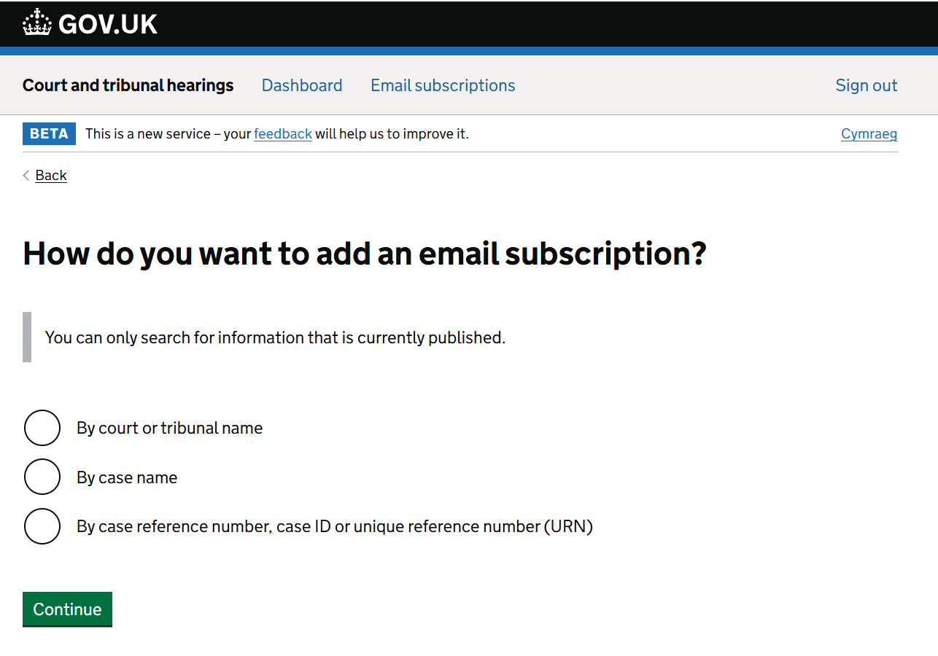
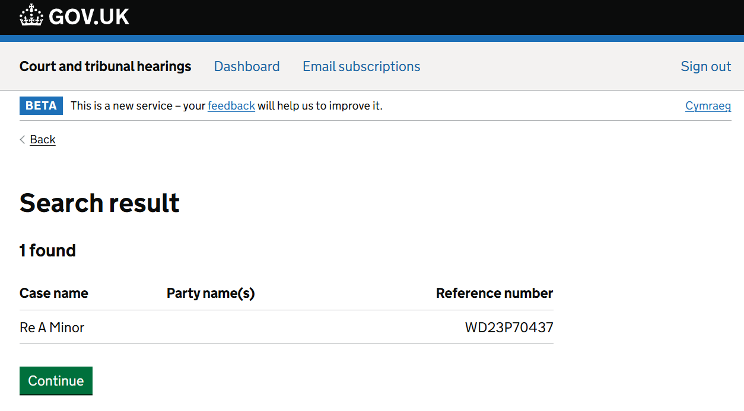
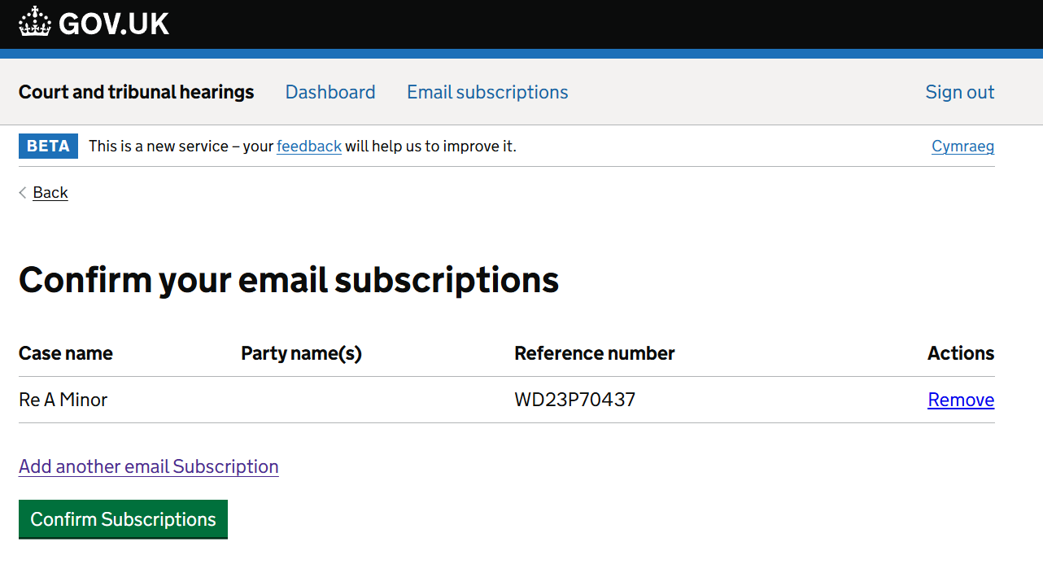
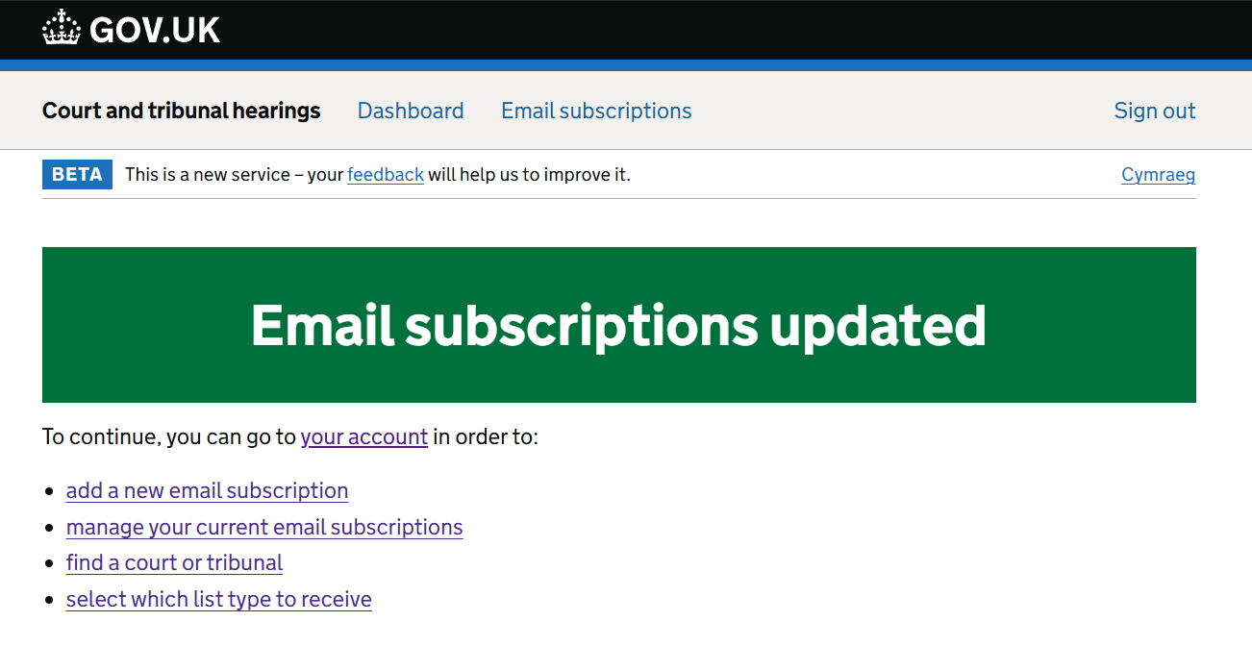
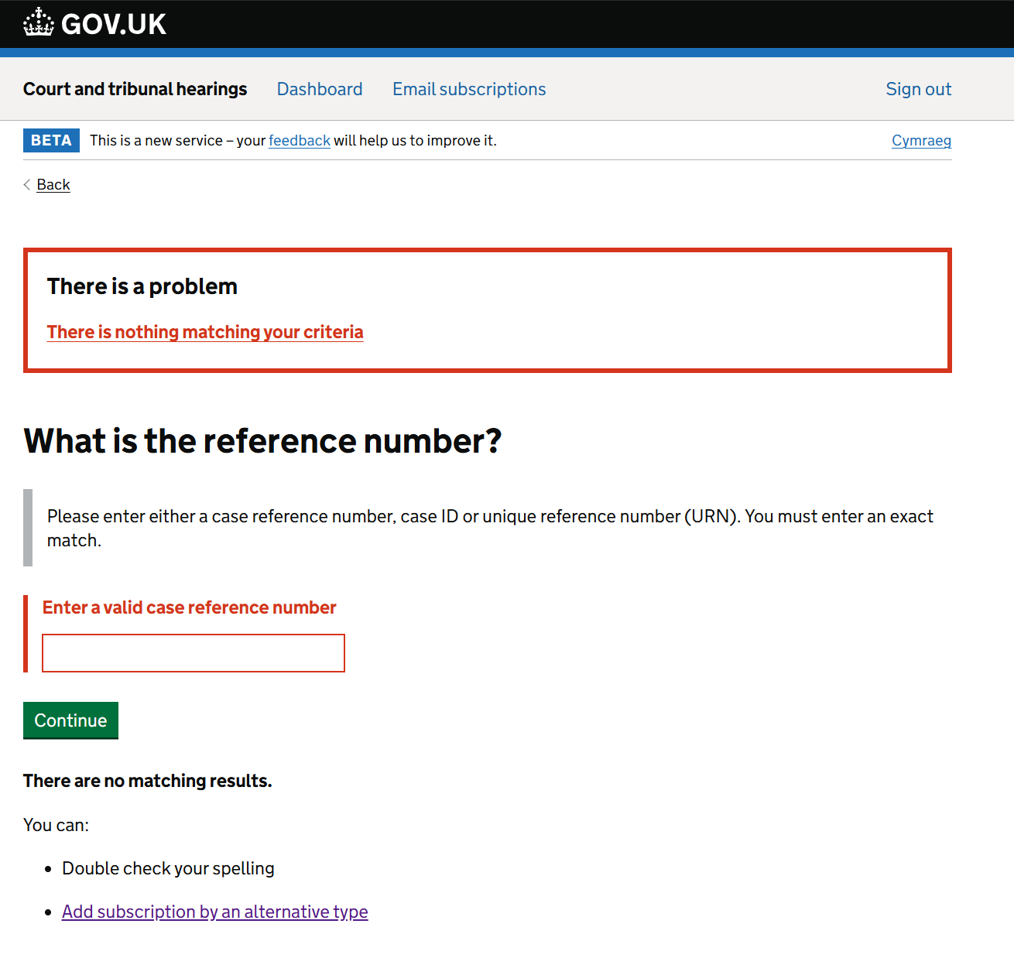
Adding an email subscription by case name or case reference number.
To subscribe via case name or case reference number a hearing list containing the case name or case reference number of interest has to be live and published on CaTH. If live, you will be able to successfully subscribe to receive any future hearing lists containing your criteria. List are usually live until midnight of the date of the hearing.
If there is no live list matching your criteria (name or case reference number) you will not be able to subscribe until the your criteria is again published.

Slide 7
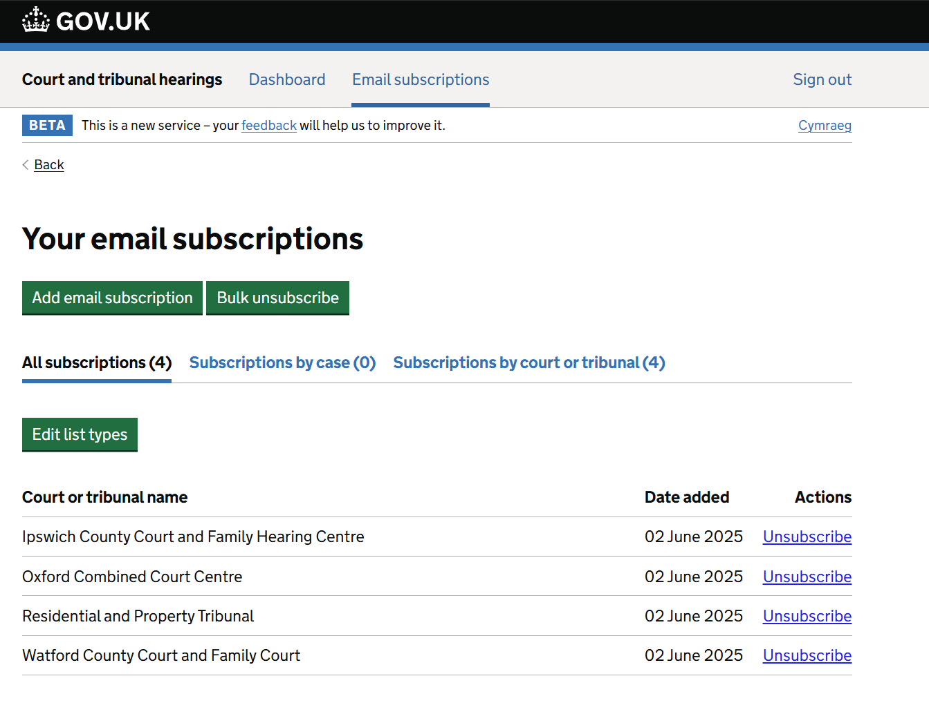
Modifying email subscriptions
You can modify your subscriptions at any time, including adding/removing courts or tribunals, bulk unsubscribe to multiple subscriptions at one time, or edit the list types you are currently receiving.
You can do this by going into your ‘Email subscription’ tab on your dashboard and clicking on either:
‘Add email subscription’ to add a new Court or Tribunal
‘Unsubscribe’ under ‘Actions’ against a particular name to remove an individual court or tribunal
‘Bulk unsubscribe’ to remove multiples
‘Edit list types’ if you wish to change the list types you are currently receiving (to remove and or add new ones).
To inform our users as and when we have onboarded new jurisdictions, we will update our homepage and also inform our subscribers of any new hearing information we’ll be publishing via our Weekly Update which is published every Friday. You can sign up for the updates.

